Slide 1
CASE STUDY:
HOTEL MANAGEMENT SYSTEM

Slide 2
OPERATING SYSTEM(Android)
WHY ANDROID?
(.) bada is only applicable on samsung phones while android is used by many different phone manufactures
(.) bada cannot do multi tasking while android can
(.) bada applications cannot access SMS and MMS while android apps can
(.) there are more apps for android than bada
(.) development on android is way faster than bada

Slide 3
ADVANTAGES OF USING ANDROID
There’s an app for almost every situation, and since its inception , android primarily focuses on enhancing user experience with the use of applications. With hundreds of thousands of apps in the android market , users will be overwhelmed by truckloads of apps that easily integrate with the android OS to cater to their needs.
When it comes to software, android can run multiple apps at the same time as it has swap-space management, a luxury that not all mobile devices support due to hardware limitations. It also has active sync built in natively, which allows you to easily synchronize contacts, mails,and personnel information once the device is paired to a desktop computer. Black berry on the other hand requires some installation of software and a server.

Slide 4
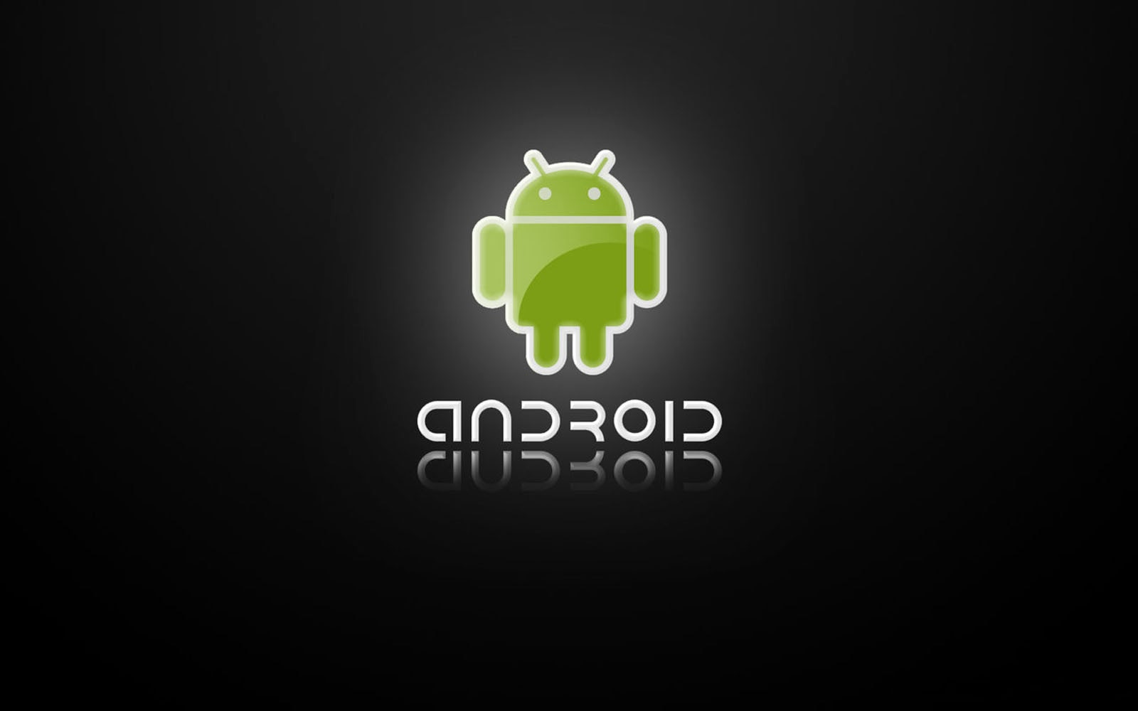
Versions of android os:
Android 9.0: Android pie
Android 8.0-8.1: Android oreo
Android 7.0-7.1:Android Nougat
Android 6.0-6.0.1:Android Marshmallow
Android 5.0-5.1.1:Android Lollipop
Android 4.4-4.4.4:Android KitKat
Android 4.1-4.3.1:Android KitKat
Android 3.0:Android Honeycomb
Android 9.0: Android pie is all about Google Assistant and using Artificial Intelligence to make everything better. Adaptive Battery and Adaptive Brightness use machine learning to increase battery life by dimming the screen when possible and keeping apps from running wild and free in the background, gestures and a single-button navigation system, app slices that bring the information you need front and center, and Digital Wellbeing so we can unwind and get away from our phones once in a while.

Slide 5
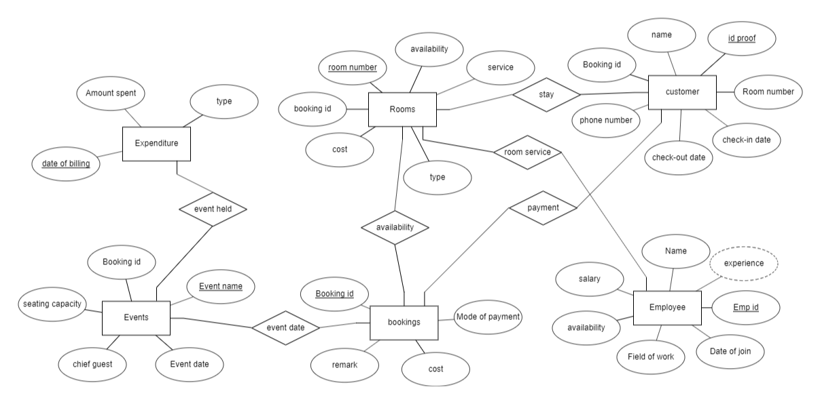
DATA BASE MANAGMENT SYSTEM

Slide 6
NETWORK METHODOLOGY
Hotels have different complimentary services. They provide Wi-Fi to guests with a considerable data transfer rate. Wi-Fi being an important component that used by all the guests, Wi-Fi is provided at all activity places like gyms, parks, parking places, event places and many more. Some hotels provide ethernet cables to each room for wired internet connection too. Intercom phones are provided to each and every room. CCTV surveillance all the time. All these devices are connected in one or the other way using particular topology. This is LAN(Local Area Network), that extends to the hotel range itself.

Slide 7
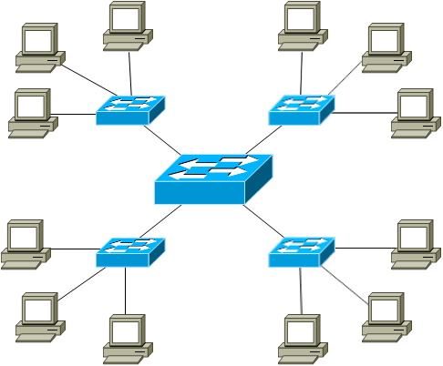
Wi-Fi NETWORK
Guest rooms
Outdoor areas
Conference and event spaces
Back office systems

Slide 8
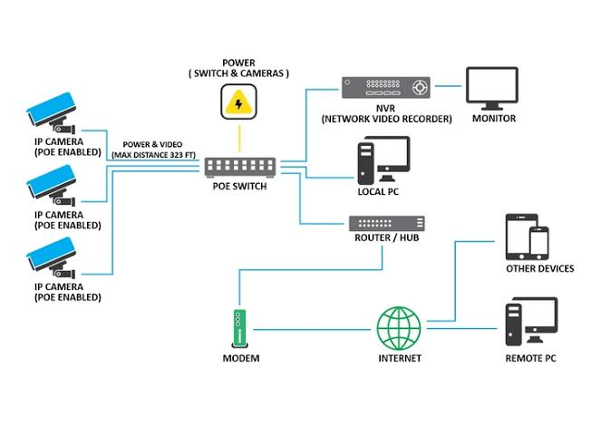
CCTV SURVEILLANCE

Slide 9
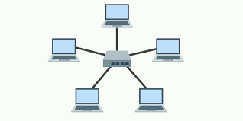
STAR TOPOLOGY
A star topology is a topology for a Local Area Network (LAN) in which all nodes are individually connected to a central connection point, like a hub or a switch. A star takes more cable than e.g. a bus, but the benefit is that if a cable fails, only one node will be brought down

Slide 10
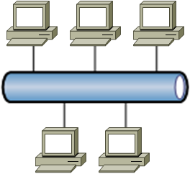
BUS TOPOLOGY
One way to think about a bus topology is that the line connected to all of the devices or nodes in the network is like an aisle along which a signal travels in order to find the node to which it is to be delivered. Typically, the cable in the bus topology has two end terminals that dampen the signal so that it does not keep moving from one end of the network to the other

Slide 11
FEATURES OF OUR APP
Guest Experience Management
Guest experience management is a broad catch-all for hotel management software that has a component meant to enhance your guests’ stay at your hotel.
Housekeeping/Maintenance Management
With hotel management software, you can actually track rooms that need cleaning or a prep before guest arrival, or even track the number of rooms that are cleaned on a given day.
Payment Processing
Payment processing features can vary across different solutions, with some able to accept multiple currencies and additional security components to prevent a data breach of sensitive customer information at your property.
Reviews Management
Many hotels opt for reviews on third-party platforms (or even Facebook), but it’s still important to include them on your homepage to reaffirm your quality of service.
OTA Integration
Integration with third-party platforms is integral to keeping your bookings organized. Imagine double booking a room because one guest went through your homepage and another went through Hotels.com. I smell a bad review coming.

Slide 12
MARKETING OUR APP
Get in Touch
Marketing your app starts long before you ever bring it to market. Before you start telling your development team to start building out your app with a million different things, reach out to your customers and talk to them.
. Use Your Social Network
Social media, despite the heavy focus by most businesses, is still a very under utilized channel of promotion. Sending the message once is good, but sending it multiple times over a month or two is even better.
Write An Announcement Blog
Announcing your app launch as a company update is a great way to keep your customers informed about a major company change. You can leverage your social network to drive traffic and cite the blog post in your email signature to make sure those you’re in contact with know your have a mobile app.
Feature the App in an Official Blog
In addition to including your app on your website, include it in your regularly scheduled blog post is another promotion strategy you can leverage.
Create An Eye Catching App Icon
With over 1.6 million apps in the Google Play Store and 1.5 million in the App Store, there’s a lot of noise in any category you choose you have your app in. Due to that noise, many people choose to take interest in apps, only when the app icon entices them.

